Slide 1



Video Game Play and Lucid Dreaming: A 20-year Retrospective
Jayne Gackenbach, ph.d.
Macewan university and Athabasca university
Poster presented at Neuroscience Needs a Revolution to Understand Consciousness, August 2023, Encinitas, CA.
jaynegackenbach.ca

Slide 2
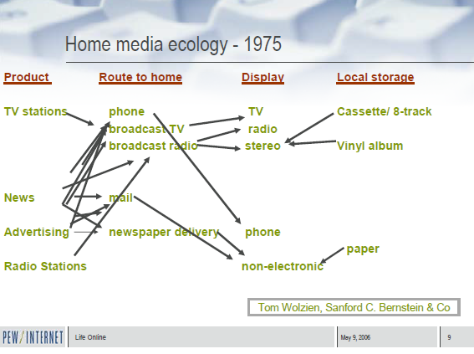
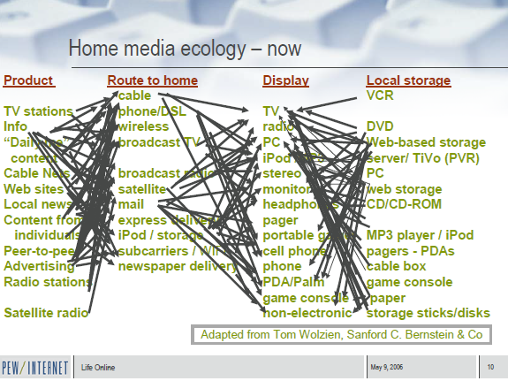
Media use
And this is only 2008………

Slide 3

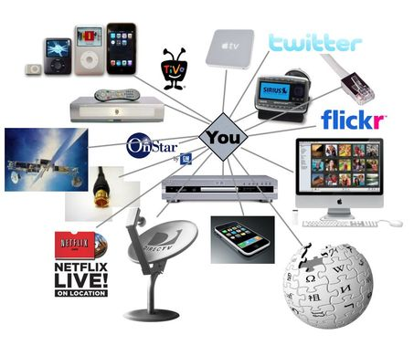


Home Media Ecology
BUT….
While these electronic media are pervasive and invasive they are not yet as immersive and wide spread as Video Games
2023

Slide 4
OVERVIEW: Conceptual background
While some waking experiences of consciousness offer an approximation of the nighttime dream state; i.e., fantasy, drug states, fever, etc.
None are as vivid and interactive as digital reality at least in terms of its widespread and easy access
The most immersive digital reality, which is widely used, is video game play
Thus, the effects of video game play on nighttime dreams have been the focus of this research
  especially lucid dreams, dreams where the dreamer knows they are dreaming while they are still in the dream
It is thought that practice in alternative realities, video games, would increase the likelihood of recognizing another reality when it occurs, i.e. nighttime dreams
Or at least impact nighttime dreams in some way
  Nightmare protection has been one finding – the fighting response of many video games translates into fighting back during nightmares where attack and chase occur.
This is theoretically based on the Game Transfer Phenomena, gaming experience transfers to various real world and imaginary world experiences (Ortiz de Gortari & Griffiths, 2012) and the generalizability of imaginal experiences in training and treatment (Krakow & Zadra, 2010)

Slide 5
OVERVIEW: This presentation
Brief survey of research examining the relationship between video game play and lucid dreaming
Topics
  Brief review of two relevant previous studies
  New data analysis using linguistic based dream content analysis
  Inclusion of additional samples

Slide 6
                Dreams of Gamers Over Time: 2006 to 2016
8 of 35 dream samples were selected based on their sample similarities and the question asked of respondent being most recent dream
Gackenbach and Velichka (2017) found weak but significant positive correlations between
  three measures of dream lucidity and year
    Judges direct assessment of lucidity
    Judges assessment using the MACE (Kahan, 1994)
    Judges assessment of dream control
  between two video game play measures and year
    Video game frequency
    Number of video games played
As time passed more people game and more report lucid type dreams

Slide 7
Individual differences in dreams and video game play: 2018
Collected media related dreams of any kind
Classified them as passive (i.e. movie, TV) or interactive (i.e., video games, social media) media dreams
  Passive were 93 dreams
  Interactive were 103 dreams
Interactive > passive on subscales of lucidity measure
  Insight
  Memory
  Realism
  Positive emotions
Interactive > Passive on gaming variables
  Game Consumption
  Problem Video Game Play
  Game Engagement
  Game Transfer Phenomena

Slide 8
External sample 2015 to 2022: Bulkeley’s Sleep and Dream Data
Website allows choice of dreams as function of various elements
The technology and science category was chosen and within that video game or computer game mentioned in the dream
50 video game dreams and 50 technology dreams with no video game mention were compared
Content analysis was LIWC-22 with proportions converted to z-scores
Compared to waking fantasy trigger from TAT (a projective test)
Content of dreams was compared using the Linguistic Inventory and Word Count (LIWC-22) system (Boyd, Ashokkumar, Seraj & Pennebaker, 2022)
  Widely used data analysis system
  Tabulates frequency of word usage
  Easy to use system via computers
  Bulkeley & Graves (2018) used it to examine dream content of nightmares and lucid dreams
  Zheng & Schweickert (2021) compared its outcomes to the Hall & VandeCastle norms

Slide 9
Lucid dreams versus waking Fantasy (TAT responses) on LIWC-22
LIWC-22 on lucid dreams (Gackenbach lab 2010) relative to TAT fantasy
Lucid dreams > TAT fantasy
  Authentic (tend to speak more spontaneously and do not self-regulate or filter what they are saying)
  Use of “I”
  Memory
TAT fantasy > lucid dreams
  Clout (relative social status, confidence, or leadership)
  Social
  Social references
jaynegackenbach.ca

Slide 10
Results video game vs nonvideo game dreams but technology on LIWC-22 selected variables
8 variables showed significant dream differences from waking fantasy
  Clout was less in dreams
  These variables are higher in dreams
    Authenticity (more)
    Use of “I” (more)
    Culture (more)
    Leisure (more)
    Home (more)
    Space (more)
  Only one linguistic variable had dream type differences
    Technology (more: gaming>nongame)
Lucid type variables from LIWC-22 showed no difference between dream types or between dreams and waking fantasy
  Cognitive processes
  Memory
  affect

Slide 11
Conclusions
Weak support for a video game – lucidity connection over 17-year period and multiple samples
Most samples from university undergraduates in western Canada
Strongest in studies where judges coded dreams and dreams were recent – no special dream type asked for
Weakest in recent data where computer aided linguistic based coding was done
  BUT LIWC offers a new direction in examining dream content
jaynegackenbach.ca

Slide 12
References
Boyd, R. L., Ashokkumar, A., Seraj, S., & Pennebaker, J. W. (2022). The development and psychometric properties of LIWC-22. Austin, TX: University of Texas at Austin. https://www.liwc.app
Bulkeley, K. & Graves, M. (2018) Using the LIWC program to study dreams. Dreaming, 29(1), 43-58.
Gackenbach, J.I. & Velichka, M. (2017, June). Dreams of Gamers Over Time: 2006 to 2016. Poster presented at IASD conference, Anaheim, CA.
Gackenbach, J.I., McDonnall, B. & Estrada, E. (2018, May). Individual differences in dreams and video game play. Paper presented at the Canadian Game Studies Meeting, Regina, Sask.
Hall, C. S., & Van de Castle, R. (1966). The Content Analysis of Dreams . New York: Appleton-Century-Crofts.
Kahan, Tracey L. (1994). Measuring dream self-reflectiveness: A comparison of two approaches. Dreaming. 4(3), 177-193.
Krakow, B. & Zadra, A. (2010). Imagery rehearsal therapy: Principles and practice. Sleep Medicine Clinics. 5(2), 289-298.
Ortiz de Gortari, A.B., & Griffiths, M.D. (2012). Chapter 11: An introduction to game transfer phenomena in video game playing. In J.I. Gackenbach (Ed.), Video game play and consciousness (p. 217-244). NY: Nova Science Publishers.
Pennebaker, J.W., Booyd, R.L., Jordan, K., & Blackburn, K. (2015). The development and psychometric properties of LIWC2015. Austin, TX: University of Texas at Austin.
Zheng, X., & Schweickert, R. (2021). Comparing hall Van de Castle coding and Linguistic Inquiry and Word Count using canonical correlation analysis. Dreaming, 31(3), 207–224. https://doi.org/10.1037/drm0000173
These and other research studies on technology and dreams can be found at jaynegackenbach.ca

