Slide 1
Dreams and Art Making as Indicators and Coping Mechanisms of Family Loss and Grief
Jayne Gackenbach
MacEwan University and Athabasca University
Paper presented at the 2026 annual conference of the International Association for the Study of Dreams

Slide 2
Dreams, Artmaking, and Grief
A Longitudinal Single-Case Study
How symbolic processing redistributes across symbolic systems - not just how it is felt
Notes:
Frame as research, not personal narrative.
Single-case but analytically structured.
Focus on symbolic systems.
Anchor: This is a study of how grief is processed across symbolic systems—not just how it is felt.

Slide 3
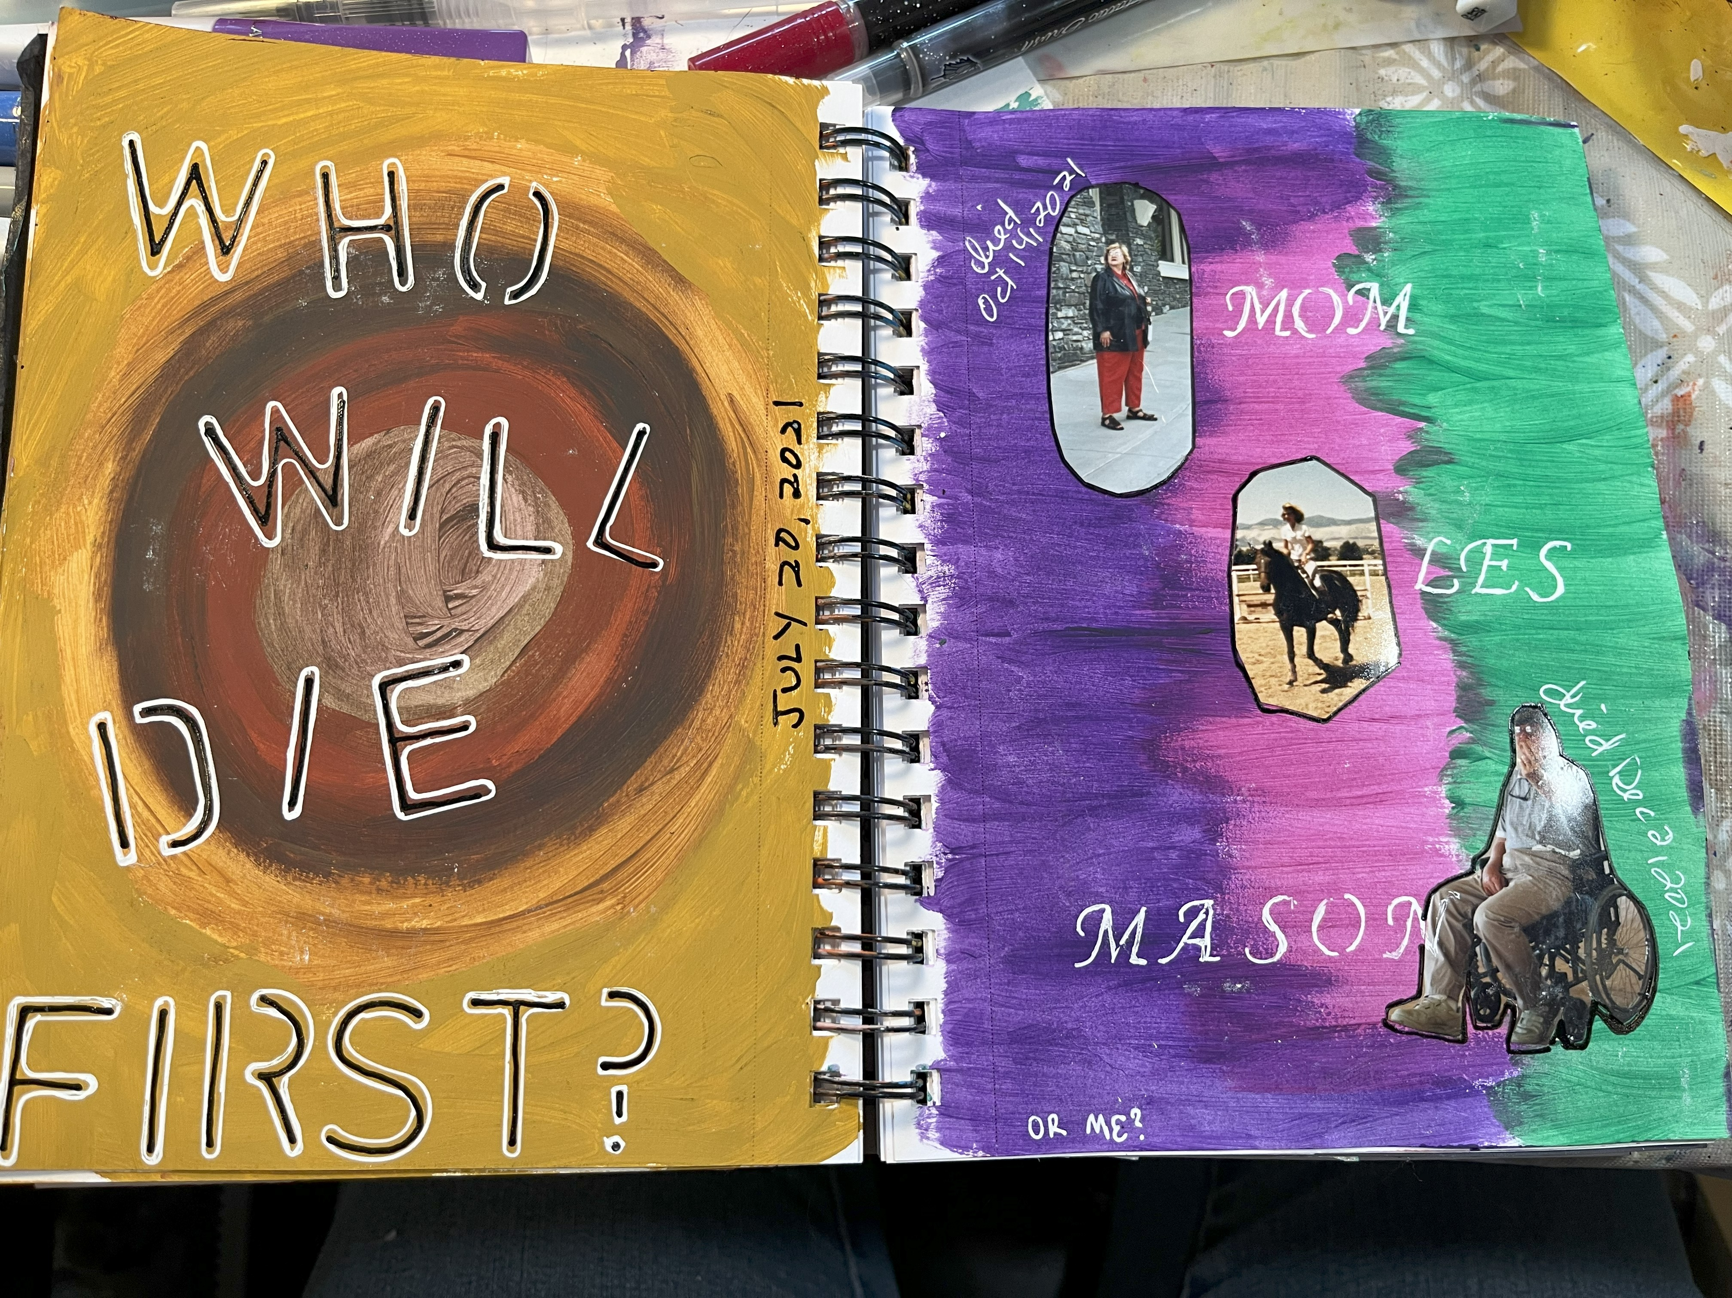
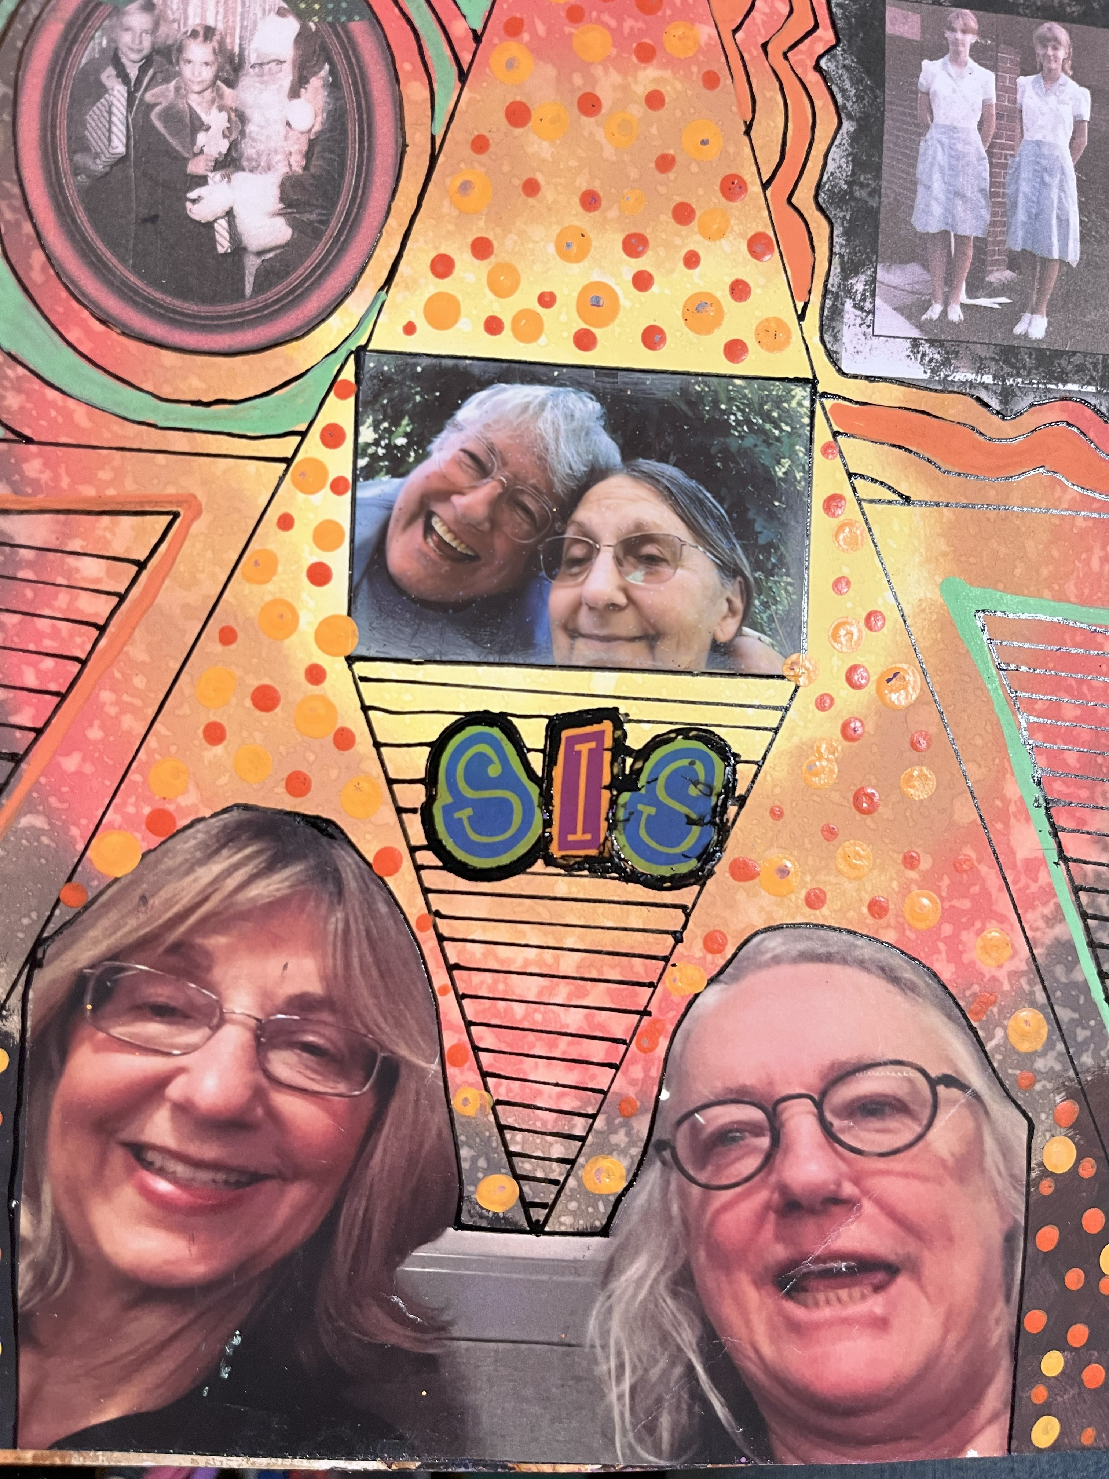
Notes:
It is important to consider why this death was so noteworthy to the author. While sibling deaths signal one’s own morality (Doka, 2002; Packman, Horsley, Davies, & Kramer, 2006), this one was singular in that there were only two siblings; her sister had no children, and her sister’s husband of 50+ years predeceased her by 4 years. Additionally, due to an earlier stroke (November of 2020), her sibling was diagnosed with vascular dementia. As her only living relative, the author maintained contact with her sister for the last five years, despite 77 years of on-and-off contact between the siblings. All other secondary relatives lived thousands of miles away. Given that the relationship was often highly contentious, this offered an opportunity for both to try to put aside their lifelong differences and enjoy each other, knowing that the end was more clearly in sight for the author’s sister than for the author. Although the author was not her sister’s primary caregiver, private senior caregivers were employed; she was the next of kin and visited her sister every few months over those five years. No other visits by family or friends occurred over the five years of dementia, except for one two-hour lunch visit by a cousin. Thus, the author played a primary supportive role in her sister’s life over the last five years and a difficult role in previous years. Despite the centrality of sibling relationships across the lifespan, adult sibling bereavement remains comparatively understudied and is frequently characterized as a form of disenfranchised grief, receiving less social recognition than parental or spousal loss (Doka, 2002; Packman et al., 2006).

Slide 4
Introduction: How does grief appear in the psyche?
Grief Literature: Dreams, Art, and Meaning-Making
Assumption: uniform expression: Measured through multiple domains
  Dreams and Grief
  Artmaking and Grief
  Jungian Theory
Implied expectation is convergence across systems.
Notes:
Footnote: Artificial Intelligence in Scholarly Work

Slide 5
What if that assumption is wrong?
Do systems change together?
Or divide the work?
Notes:
Question the assumption directly.
Do systems move together or specialize?
Anchor: We tend to assume the psyche speaks with one voice—but what if it doesn’t?

Slide 6
Core Question
Uniform grief processing?
Or redistribution across systems?
Notes:
Organizing question.
Not about intensity, but distribution.
Anchor: Is grief expressed uniformly—or divided across systems that do different kinds of work?

Slide 7
METHODS
Data
Procedure
Data Corpus -Single-case but dense data.
  Dreams (n=76)
  Artwork (n=260)
  AI Jungian interpretations in real time (n=76)
Coding
Dreams (HVDC & Jungian)
Artwork (qualitative & quantitative)
ChatGPT real time interpretations (qualitative)
Time-bounded around clear event.
Data divided into three phases:
  Preevent: two months prior to sisters last stroke
  Event: month from stroke to burial
  Postevent: two months after burial
Strength: within-person comparison over time.
Notes:
Dreams: Meta-analysis of real time AI assisted Jungian interpretations - the author coded all dreams but adjusted HVDC coding was done with ChatGPT
Artwork: quantitative system developed with ChatGPT based on existing literature
Artwork: qualitative analysis of 10 emblematic works per time phase
AI interpretations: these texts are not treated as independent symbolic productions, but as derivative interpretive artifacts reflecting a specific analytic stance at a given moment in time. They are used to examine the evolution, stability, and thematic emphasis of interpretation across phases, rather than as authoritative readings of dream meaning

Slide 8
Do these systems change together?
If grief is uniform, these systems should change together.
Notes:
Set expectation: audience likely expects parallel change.
Anchor: If grief is uniform, these systems should change together.

Slide 9
Results
All dreams were coded (76)
9 artworks were selected by the artist from each phase along the lines suggested by ChatGPT’s synthesis (27 artworks coded)
What to code was in consultation with ChatGPT but the actual coding was done by the author in all variables but the last
HVDC Adjusted Content Analysis
Qualitative Dream Analyses
Quantitative Artwork Analysis
Qualitative Artwork Analyses
Qualitative ChatGPT real time Jungian Analysis

Slide 10
Dream Structure
No phase differences
Stable across time
Notes:
No statistical differences despite major event.
Surprising finding.
Dreams not tracking event structurally.

Slide 11
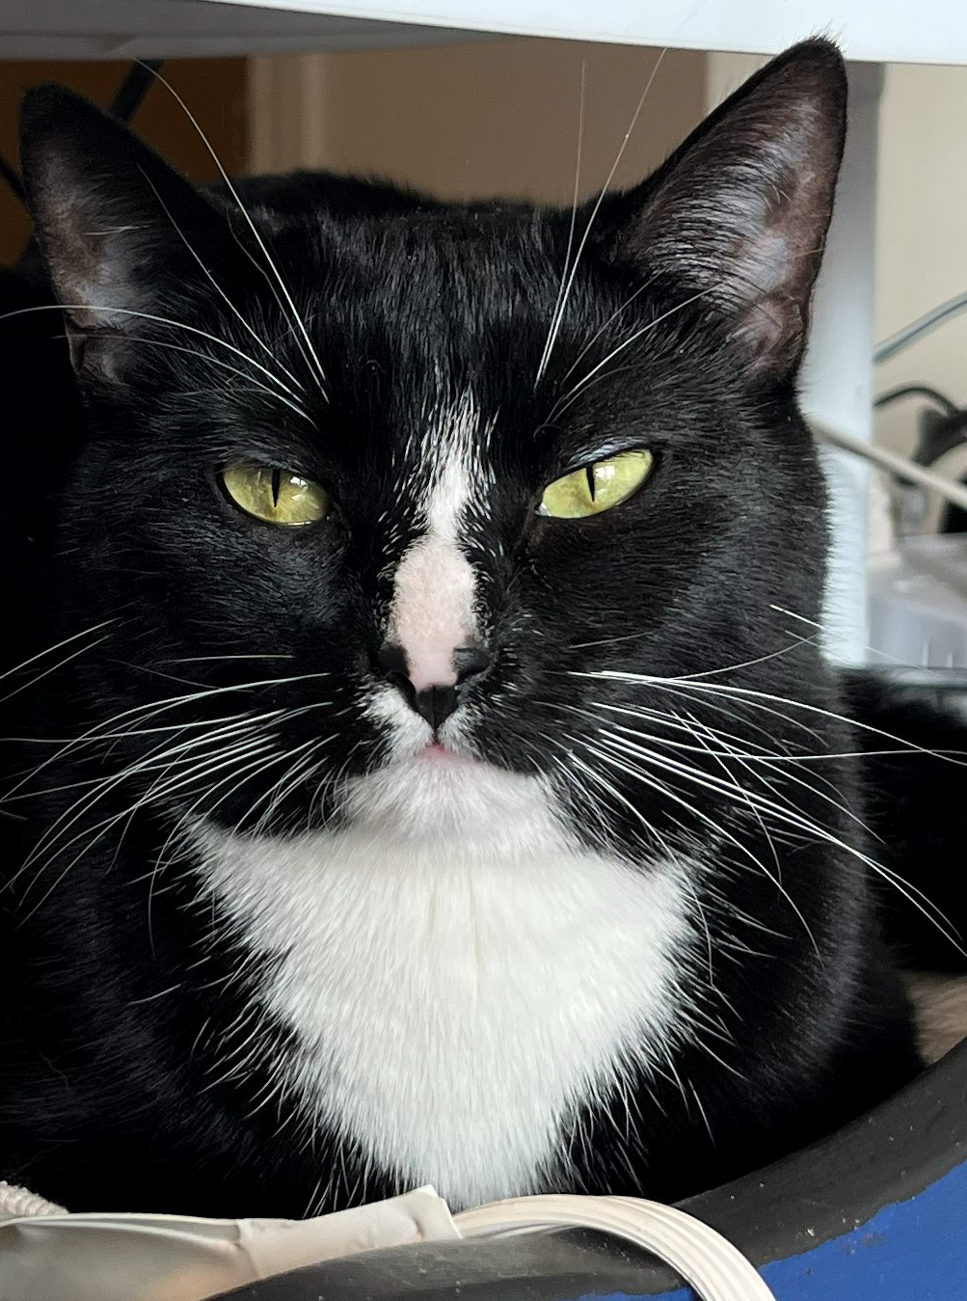
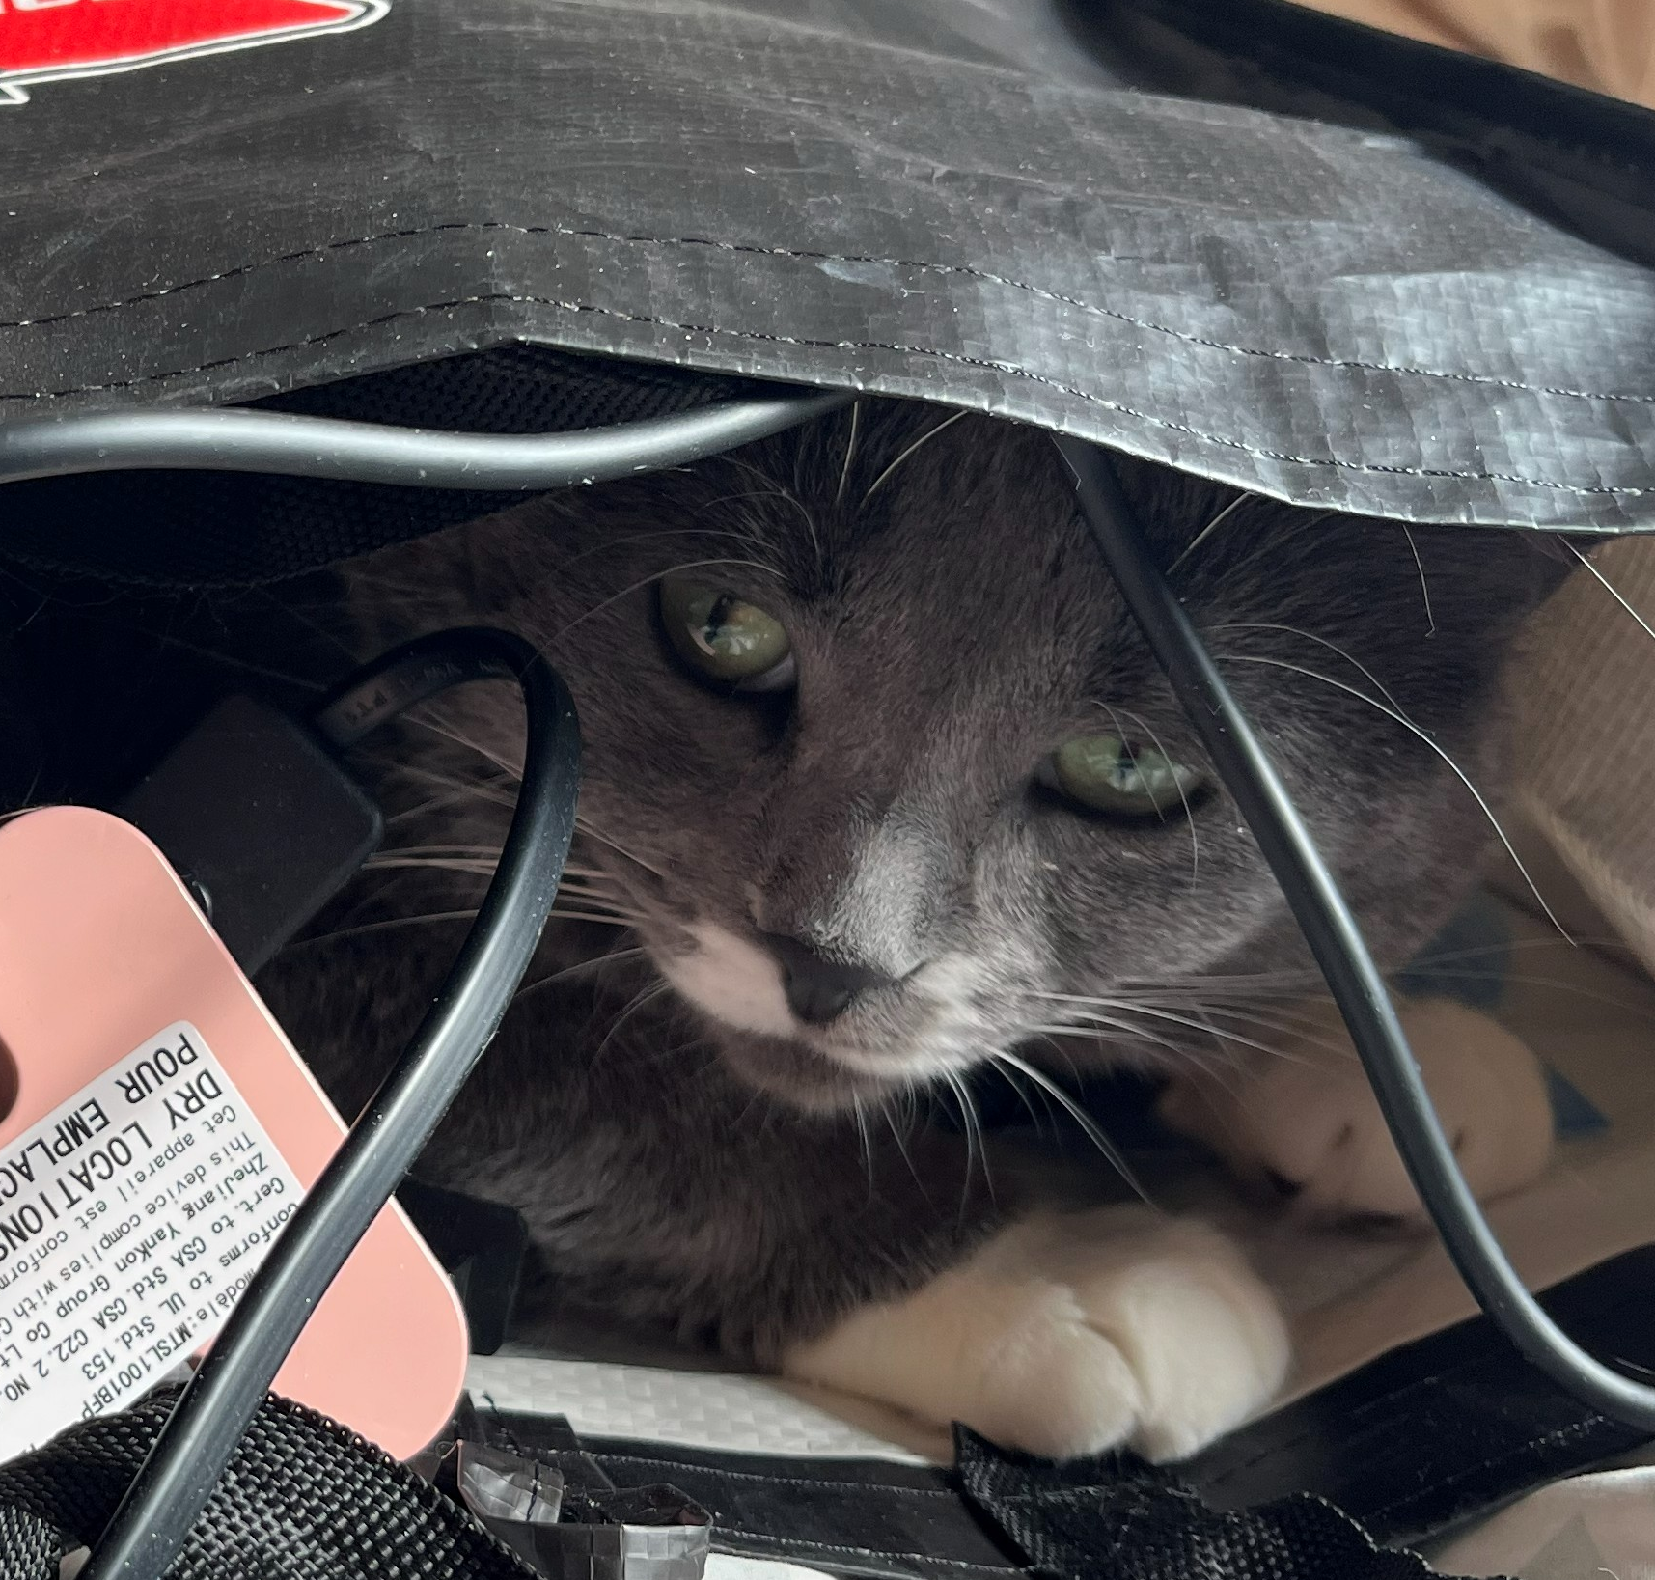
Dream Profile
Elevated fear
Animals
Aesthetic attention
connects to art processing
Notes:
Trait-like features.
Aesthetic attention connects to art processing.

Slide 12
Dreams: Stable, But Not Isolated
No structural change
Aesthetic sensitivity persists
Links to art processing
Dreams do not show the change—but they remain tuned to the same symbolic register as the system that does.
Notes:
No structural change.
Aesthetic sensitivity mirrors artwork.
Systems connected, not independent.
Anchor: Dreams do not show the change—but they remain tuned to the same symbolic register as the system that does.

Slide 13
But meaning did change
ChatGPT-5 interpretations of dreams AT THE TIME OF THE DREAM
Prompt was to do a Jungian analysis
Notes:
Shift from structure to meaning.
This is where change begins.

Slide 14
Interpretive Evolution
But meaning did change
Pre: exploratory
Event: death-aware
Post: reorganization
CLEAR PHASE PROGRESSION
INTERPRETATION TRACKS PSYCHOLOGICAL REALITY
Notes:
Clear phase progression.
Interpretation tracks psychological reality.

Slide 15
Example Shift: This is where the systems touch—an art object inside a dream used to make death tolerable.
Oct 8 2025 (night before she died): Dreamt I saw a sculpture of a black cat – it was a rough sort of work using children’s plastic bricks. The outline of the piece was like a frame, same material but higher than the surface of the sculpture. It was fairly large and it was clear that it was in the foreground but I do not recall what was in the background or rather it was just grey kind of fog.
Chatgpt prompt: “please interpret this dream from a Jungian perspective and keeping in mind that i'm doing a death watch with my sister. She was brought home yesterday to die in her bedroom where she still has a cat tree where her cat used to sit a lot. The cat was black with white feet, chest and nose markings. I have a cat as well with those markings.”
Notes:
Tower dream: emergence of structure. Oct 3 2025
Black cat: confrontation with death. Oct 8 2025
Art object inside dream.
Anchor: This is where the systems touch—an art object inside a dream used to make death tolerable.
Pre: symbolic
Event: threshold
Post: restructuring

Slide 16
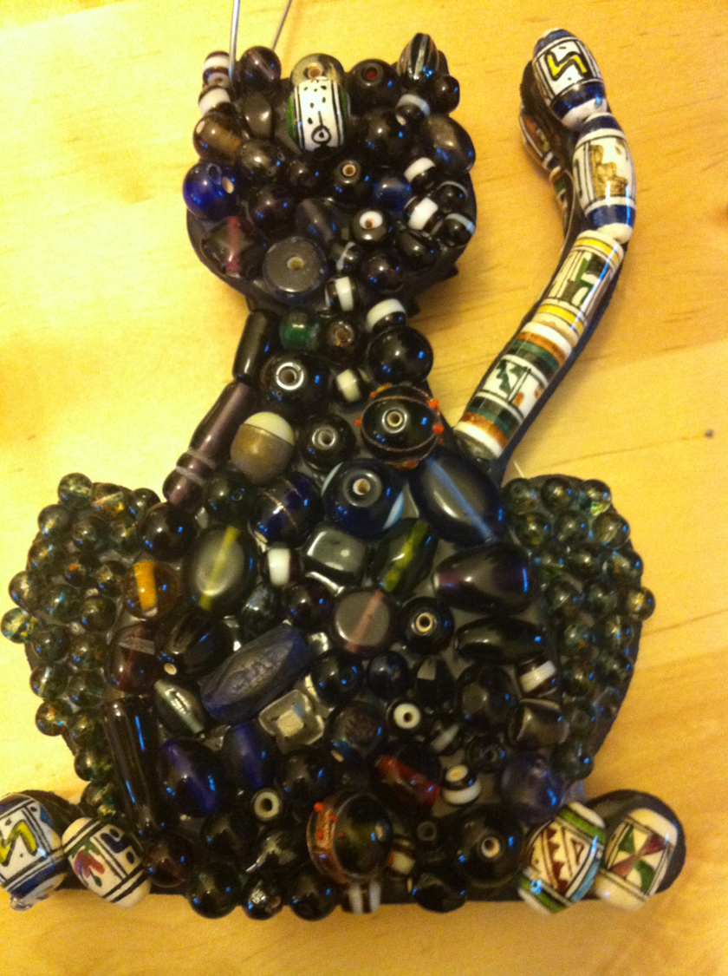
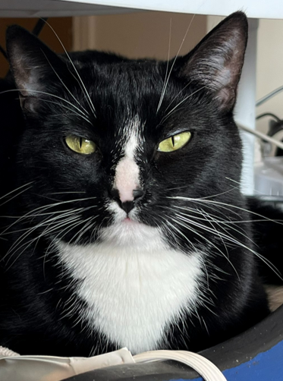
Black cat sculpture dream
(Oct 8, 2025 — day before death)
“Death made tolerable through form”
→ Dream contains art object → links dream and artwork systems
Notes:
Black cat sculpture was made in 2011

Slide 17
Meaning Moves Before Structure
Meaning evolves even when structure does not.
Change is uneven across systems.
Notes:
Meaning evolves even when structure does not.
Change is uneven across systems.

Slide 18
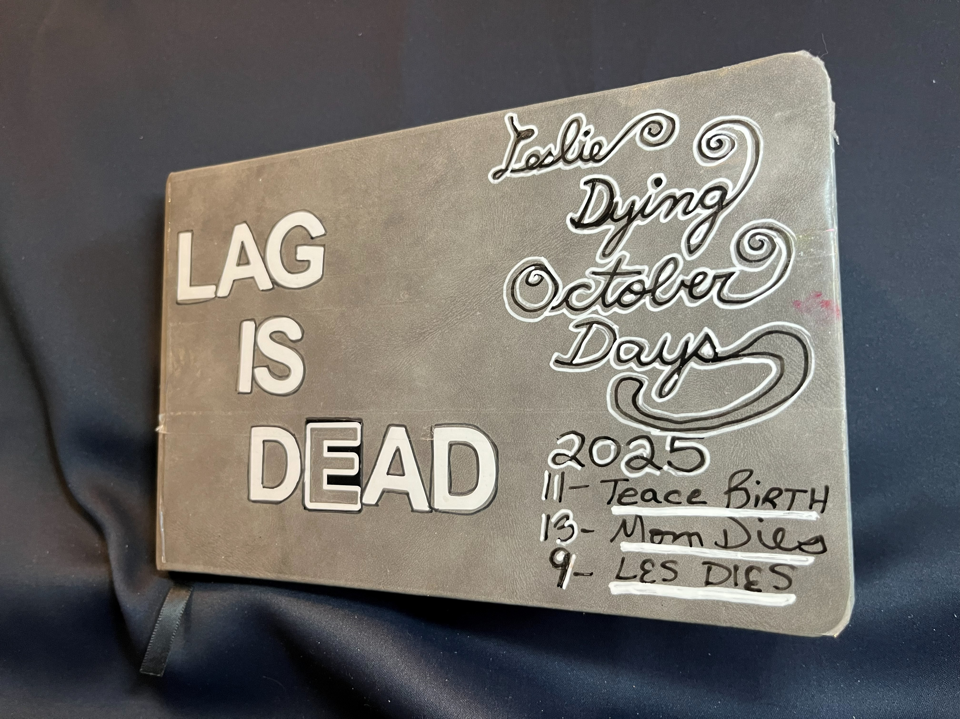
Where does change appear?
Notes:
Transition to artwork.
Where is transformation visible?

Slide 19
Artwork: Measurable Change
↑ meaning, intensity, agitation, expansion
↓ coherence
Notes:
Significant increases in expressive variables.
Decrease in coherence.
Quantitative evidence of change.

Slide 20

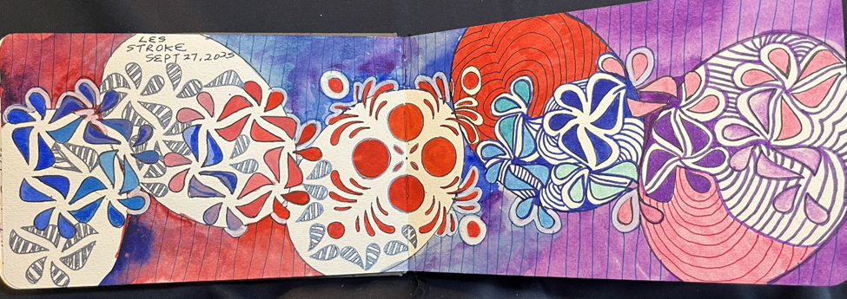
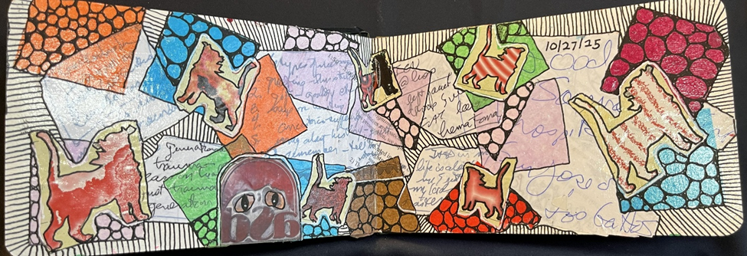
Artwork Across Phases
Phase 1: containment
Phase 2: rupture
Phase 3: reorganization
Notes:
Visual arc matches theory.
Use images to illustrate.

Slide 21
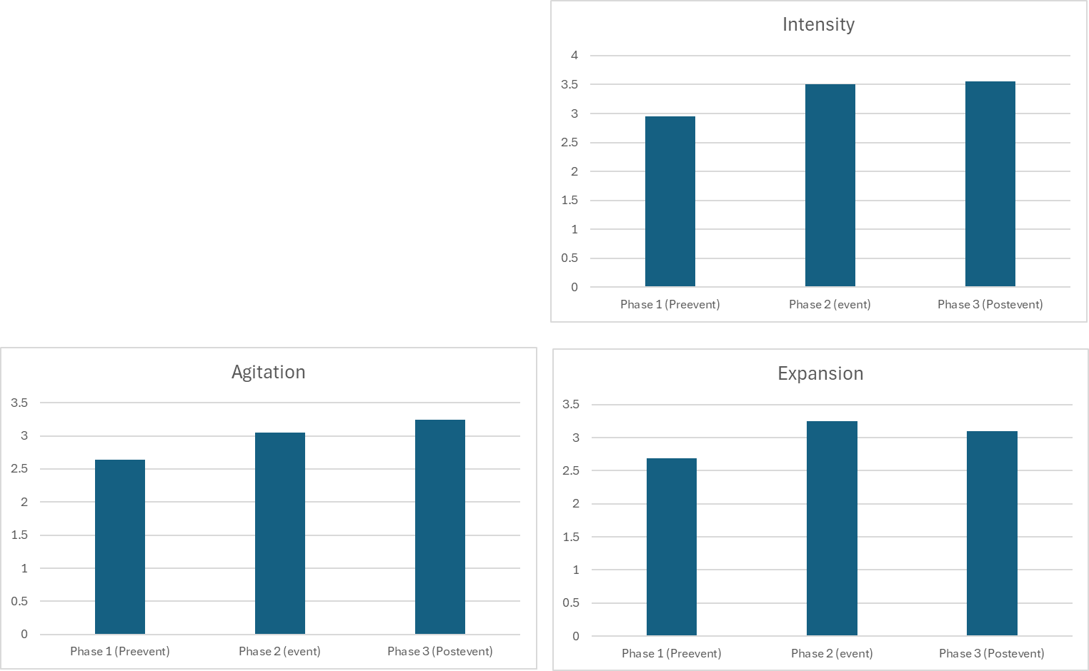
Significant increase in Intensity, Agitation and Expansion from pre-event to event and post-event

Slide 22
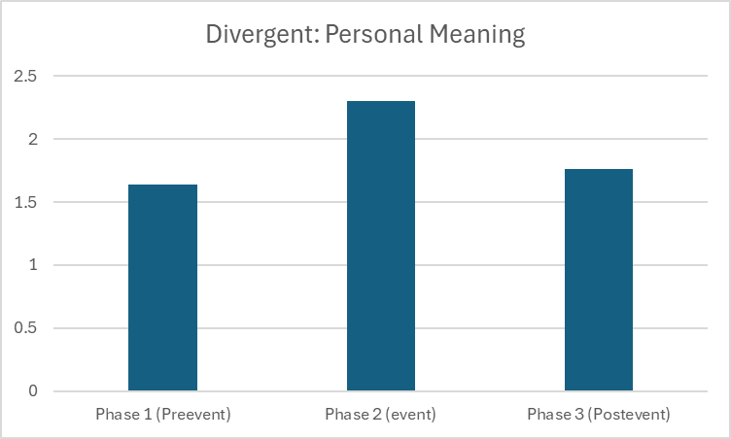

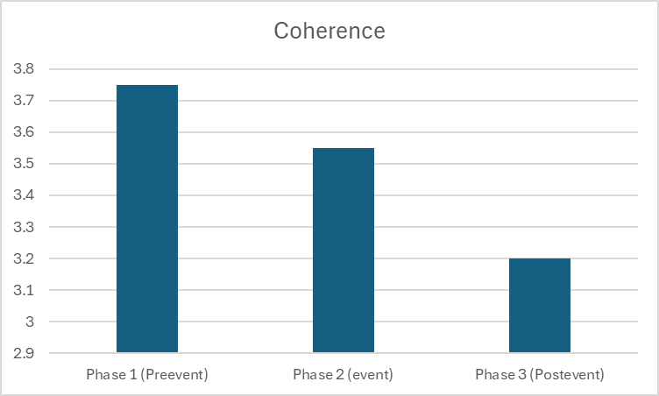

Slide 23
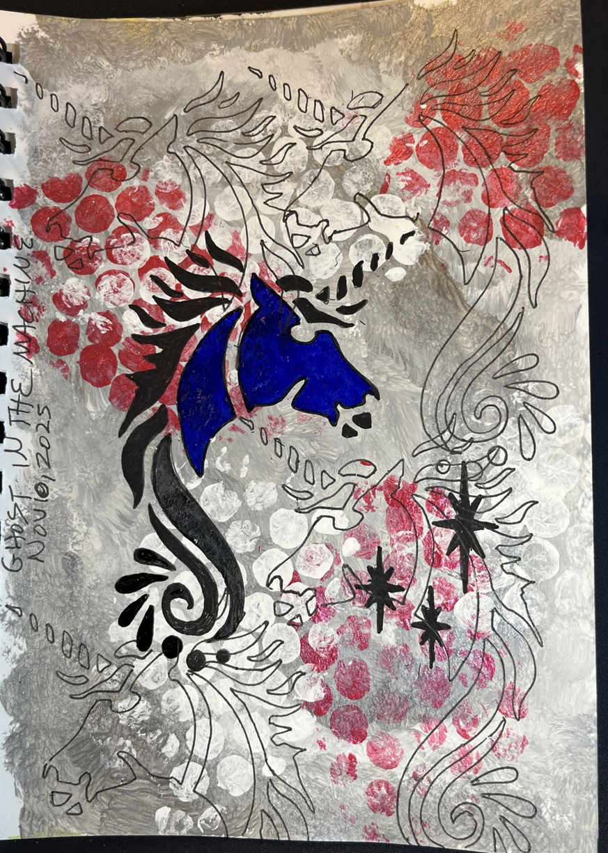
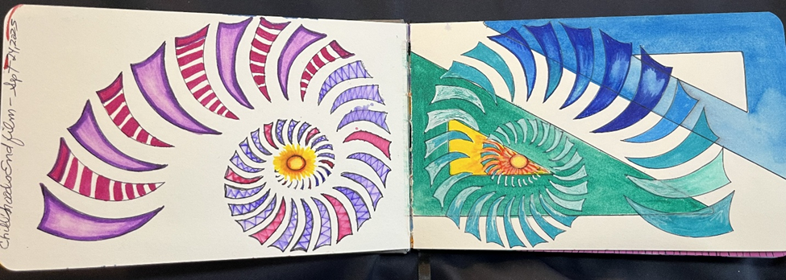
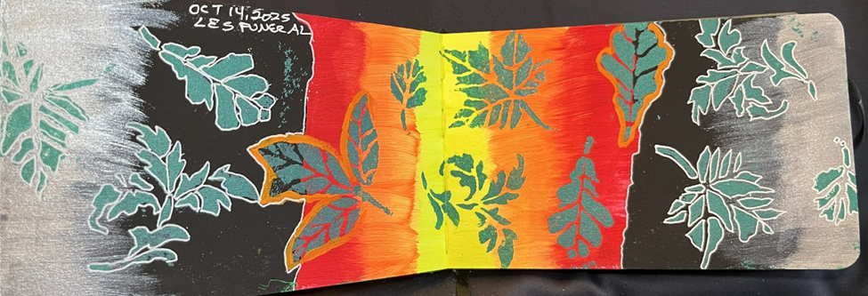
Art Carries the Transformation
Visible
Measurable
Progressive
Notes:
Key empirical finding.
Art shows transformation.
Anchor: Art is where grief becomes visible.

Slide 24
Symbolic Work is Distributed — Not Separate
Dreams: stable + linked
Interpretation: evolving meaning
Art: transformation
Grief is not processed in one place—it is distributed across systems, each doing different psychological work.
Notes:
Systems differentiated but linked.
Anchor: Grief is not processed in one place—it is distributed across systems, each doing different psychological work.

Slide 25
conclusion
Grief in this case did not manifest as linear escalation or resolution.
Dream structure remained largely stable, artwork intensified and fragmented during crisis, and interpretive stance evolved from anticipation to confrontation to reorganization.
Symbolic processing was redistributed across modalities rather than resolved within one.
These findings support viewing grief as ongoing psychic reconfiguration rather than closure.

Slide 26
Final Thought
The psyche does not process grief in one place
—it distributes the work
Notes:
Return to core claim.
Anchor: The psyche does not resolve grief—it reorganizes around it.

Slide 27
THANK YOU
Slides at: Jaynegackenbach.ca
Email: jgackenb@yahoo.com

