Slide 1
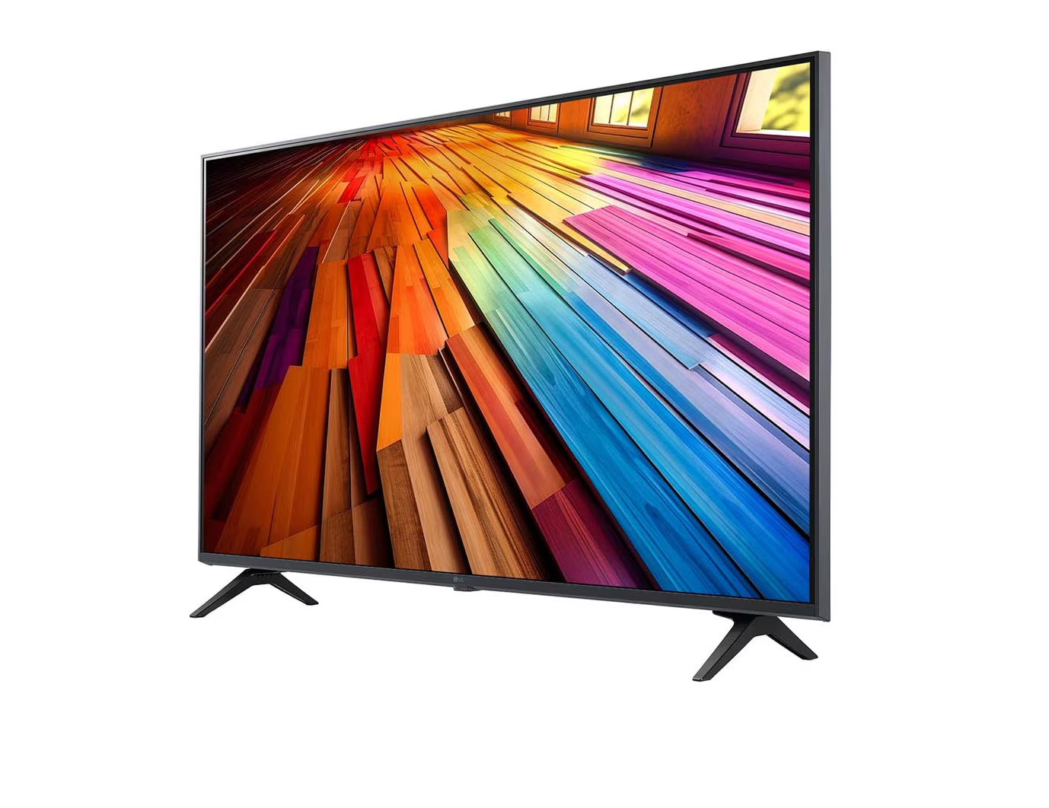

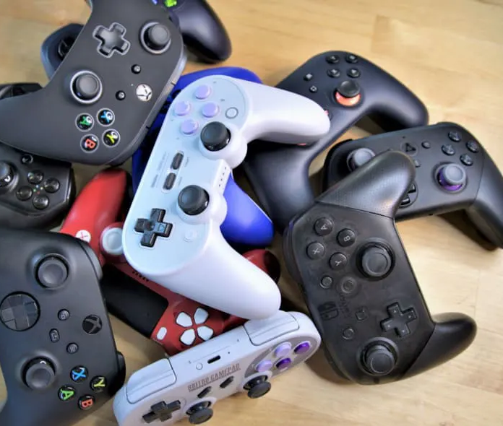
Nighttime Dreams and Waking Fantasies about Media: Similarities and Differences
Jayne Gackenbach, PhD
MacEwan University and Athabasca University
Paper presented at the 2026 annual conference of the International Association for the Study of Dreams
ChatGPT and SPSS used in parts of this research project

Slide 2
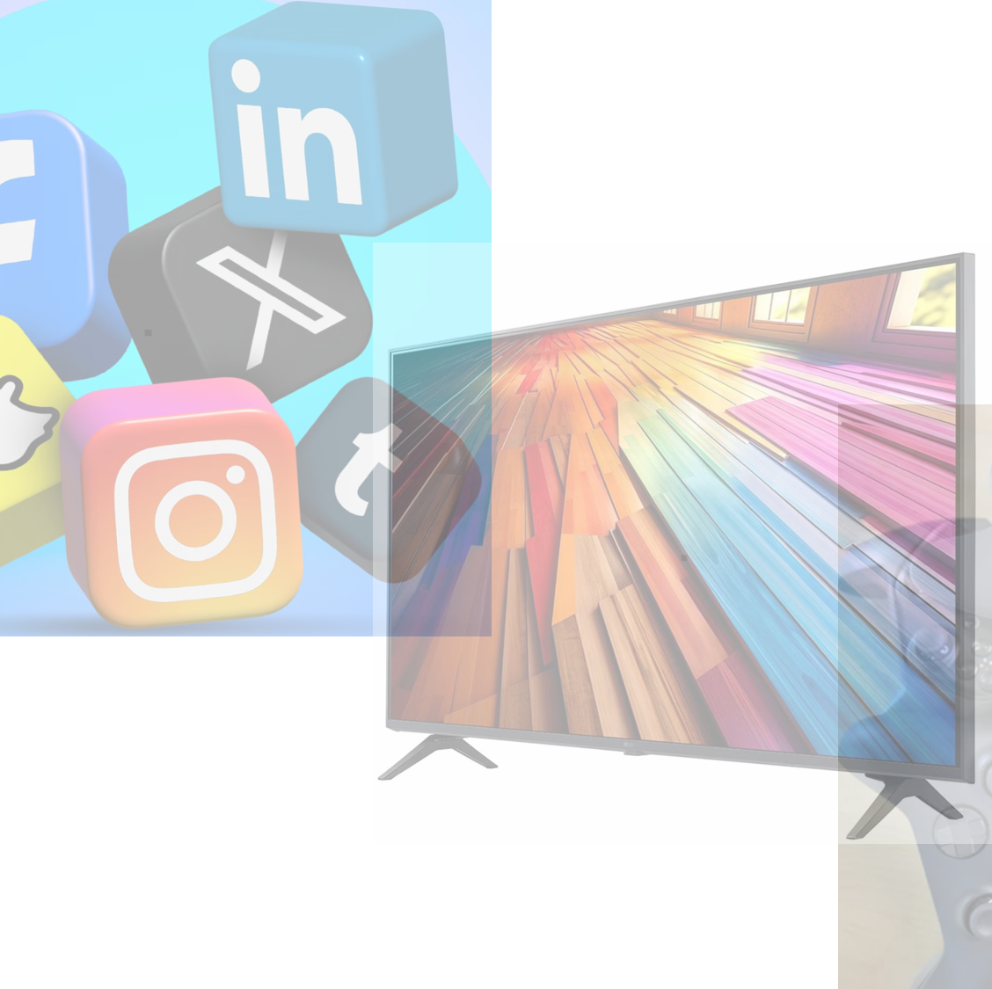
Background
Research on the relationship between waking imagination (day-dreaming, fantasy-proneness) and dreaming frequently finds some overlap in general experiential or trait-based variables (e.g., absorption, fantasy-proneness, imaginative engagement) but much weaker or more nuanced overlap in specific content of fantasies versus dreams.
Notes:
For example, Ross Levin & Hugh Young (2001/02) found that fantasy-proneness and absorption strongly predicted dream recall and dream vividness, yet did not demonstrate simple one-to-one content overlap between fantasies and dreams (i.e., the particular fantasies people engaged in did not map neatly onto the exact dreams they reported). drrosslevin.com Similarly, Michael Schredl (2003) reviewed diary-based and activity-based studies of the continuity hypothesis in dreaming and concluded that while waking‐life activities might influence dreams, the relationship is conditional on type of waking activity, emotional involvement, and other moderating factors—and therefore “the continuity hypothesis in its present general form is not valid and should be elaborated” (p. 573). PubMed

Slide 3
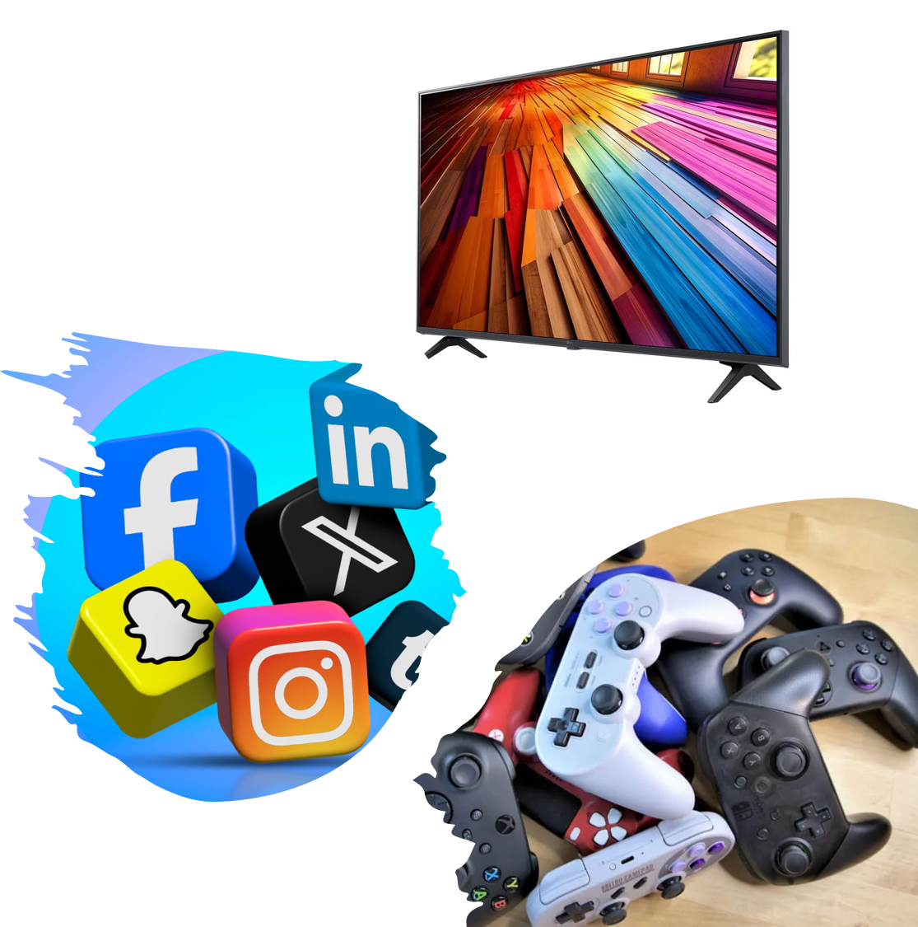
Gap
No study seems to measure waking fantasies specifically about media (e.g., fantasizing about gaming, movies, social media) and measure dreams that contain media references in the same participants, with a content-comparison focus.
The closest deals with media consumption (behaviour/exposure) rather than fantasy about media, or with fantasy in general (not media-specific) rather than media fantasy.
Therefore, exploring fantasy about media and dream media content is relatively novel.
Allows an inquiry into how much media influences “unconscious” processes

Slide 4
methods
Online survey
Course credit in introductory psychology
Online university in western Canada
Length about 1 to 1 ½ hours
Online for 3 years (2023-2026)
Major sections
  Dream about media and follow-up questions
  Fantasy about media and same follow-up questions
  Several related brief questionnaires

Slide 5

Questionnaires (brief types and in this order)
Demographics
Game Transfer
Social Media Use history
Problem Video Game Play
Type of Social Media used
Video Game Play Patterns
Cell Phone Use Questions
Social Networking Habits
Emphasis on new media not standard media (i.e., books, TV, radio)
Due to expectation of
age of respondents
Not used in
current results
report

Slide 6
Demographics of Respondents
Gender:
  mixed = 26;
  male = 169;
  female = 496
Age:
  18-25=270;
  26-35= 268;
  36-45=113;
  46-55=31;
  56-65=5;
  66-75=1
Relationship:
  in some sort of relationship = 159;
  married = 176;
  single = 357
First language:
  English = 559;
  French = 10;
  Other = 123
Somewhat classic profile of Psychology student research participants in western Canada

Slide 7
Factor analysis on 38 self report questions about media dreams and media fantasies
self report of dream has media in it
Fantasywhy selfre of fantasy has media in it
dream word count
fantasy_word_count
When was the dream
mediausedayb4[a1] work/study/infoseek
mediausedayb4[a2] gaming
mediausedayb4[a3] socialmedia
mediausedayb4[a5] TV,movie,music passive
drcharacteristics[sq001] Lucid
drcharacteristics[sq002] Control
drcharacteristics[sq003] nightmare woke
drcharacteristics[sq004] nightmare no woke
drcharacteristics[sq005] bizarre
drcharacteristics[sq006] 3rd POV
presence adjust to wake
presence people look like awake
presence people sound like awake
dremo[sq001] positive
dremo[sq002] neutral
dremo[sq003] negative
Fantasywhen
fantasymediause[a1]
fantasymediause[a2]
fantasymediause[a3]
fantasymediause[a5]
fantasycharacterize[sq001]
fantasycharacterize[sq002]
fantasycharacterize[sq003]
fantasycharacterize[sq004]
fantasycharacterize[sq005]
fantasycharacterize[sq006]
Fantasyadjustback
Fantasypeolook
Fantasypeosound
fantasyemo[sq001]
fantasyemo[sq002]
fantasyemo[sq003]
Media Inclusion
Content characteristics
Presence
Emotions
Notes:
deleted dreams with<50 words

Slide 8

Factors which emerged
Factor name |  | Factor explained
1drfan mediau dayb4 |  | Dream and fantasy self reported media use day before mentation
2dream ntmare emo |  | Dream nightmares with emotions
3fan ntmare emo |  | Fantasy nightmares with emotions
4fan presen |  | Fantasy presence
5dr presen |  | Dream presence
6drfan gaming dayb4 |  | Dream and fantasy gaming day before dream/fantasy
7 fan 3rdper |  | Fantasy 3rd POV
8fan lucid |  | Fantasy lucid sort of
9drfan word |  | Dream and fantasy word counts (note all dreams less than 50 words not included)
10drfan adjust |  | Dream and fantasy adjust back to reality
11drfan when |  | Dream and fantasy when had experience
12dr lucid |  | Dream lucid and related
13drfan mediaself report |  | Dream and fantasy self report of media in mentation

Slide 9
Interpretation
all self report of experience (dream/fantasy) on same person about the mentation:
6 of 13 showed the same thing in dream as in fantasy – tends to NOT be about content of mentation
7 of 13 were distinct for dream (3) and for fantasy (4) – tends to be about content of mentation
In other words dreams are and are NOT the same as fantasy – or at least not when Ss asked for a sample with media inclusion
tidy partition between process continuity and content discontinuity.

Slide 10
Joint factors (dream + fantasy)
➡ Interpretation: These six continuity factors reflect ego-syntonic functions—habitual cognitive or self-regulatory styles that persist across waking and dreaming. They’re about how the mentation is experienced or framed, not what it depicts.
Factor | Core meaning | Nature of continuity
1 drfan mediau dayb4 | Media use day before mentation | External behavioral continuity (state-dependent priming).
6 drfan gaming dayb4 | Gaming exposure day before | Same domain, behavioral continuity.
9 drfan word | Word count | Linguistic productivity or elaboration tendency—a stylistic/trait factor.
10 drfan adjust | Ease of adjusting back to waking reality | Post-mentation integration capacity.
11 drfan when | Temporal recency of the mentation | Contextual memory linkage.
13 drfan mediaself report | Explicit recognition that the mentation involved media | Metacognitive overlap—awareness rather than content.
Notes:
ego-syntonic functions-

Slide 11
Dream-specific vs. Fantasy-specific factors
Domain | Factor | Meaning | Key contrast
Dreams | 2 dream ntmare emo, 5 dr presen, 12 dr lucid | Affectively charged, embodied, occasionally metacognitively aware states. | Emotional immediacy and felt presence.
Fantasies | 3 fan ntmare emo, 4 fan presen, 7 fan 3rdper, 8 fan lucid | Controlled, often third-person, representational elaborations. | Observational stance and volition.
Interpretation: These seven content-driven factors capture differentiation of ego stance:
Dreams: immersive, affect-laden, symbolic.
Fantasies: reflective, representational, consciously modulated.

Slide 12

Discussion: Implications
The present findings contribute to an emerging refinement of the continuity hypothesis
Empirically demonstrating a dissociation between process and content in waking–dream relationships

Slide 13
Limitations and Future Directions
Although the present analyses illuminate meaningful process–content distinctions, several limitations should be noted.
The dream and fantasy data were obtained within the same survey session, so contextual differences in administration are unlikely to explain the lack of content correspondence.
However, because participants always described a dream before a fantasy, order effects cannot be ruled out.

Slide 14
Concluding Summary of Self-Report Data
Taken together, the findings demonstrate that continuity between waking fantasy and dreaming cannot be assumed at the level of shared content, even when both mentations explicitly involve media themes.
Instead, continuity emerges in the underlying structure and self-referential framing of experience—how participants report, elaborate, and integrate imaginative events across states of consciousness.
By distinguishing between process and content, this study refines the continuity hypothesis to reflect a dual reality of imaginative life: a stable scaffolding of cognitive and expressive habits that persist across wake and sleep, and a shifting symbolic language that transforms when ego control relaxes.
Dreams thus appear less as replicas of waking fantasy than as autonomous reworkings of its motifs, translating personal media imagery into new configurations of meaning.
These results invite further exploration of how contemporary media environments interact with imagination in both waking and dreaming states, and how these interactions reveal the evolving ecology of the modern mind.

Slide 15
THANK YOU
Slides at: Jaynegackenbach.ca
Email: jgackenb@yahoo.com

