Slide 1
Working with ChatGPT: Personal dreamwork and research assistance
Jayne Gackenbach, PhD
MacEwan University and Athabasca University
Paper presented at the 2026 annual conference of the International Association for the Study of Dreams
Slides are on my website: jaynegackenbach.ca

Slide 2

What will be covered
Brief personal history of teaching and research with computers and the Internet
Personal Research use of ChatGPT
Personal Dreamwork with ChatGPT

Slide 3

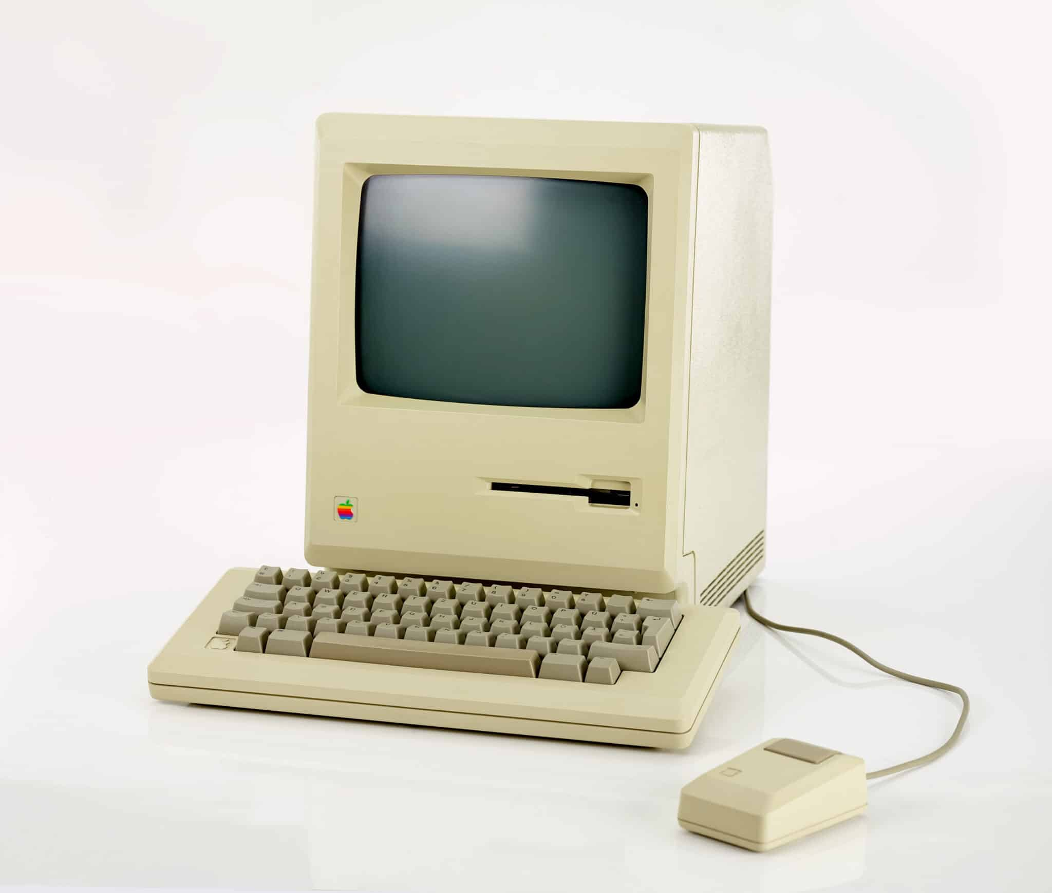
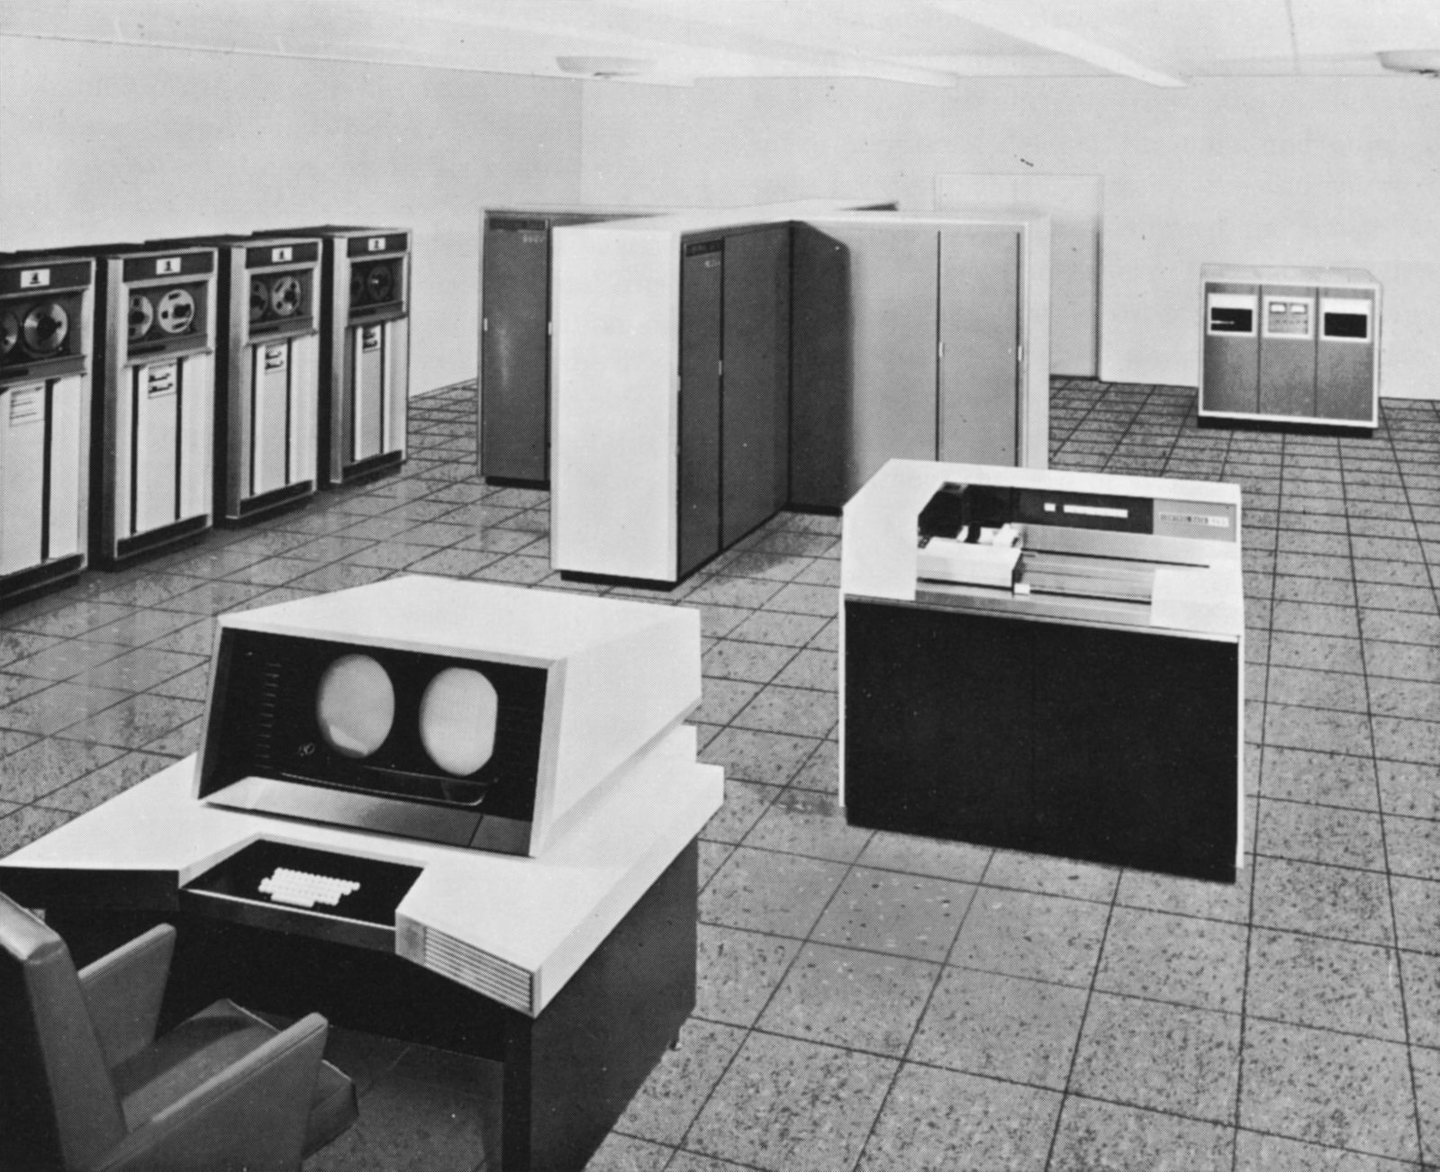
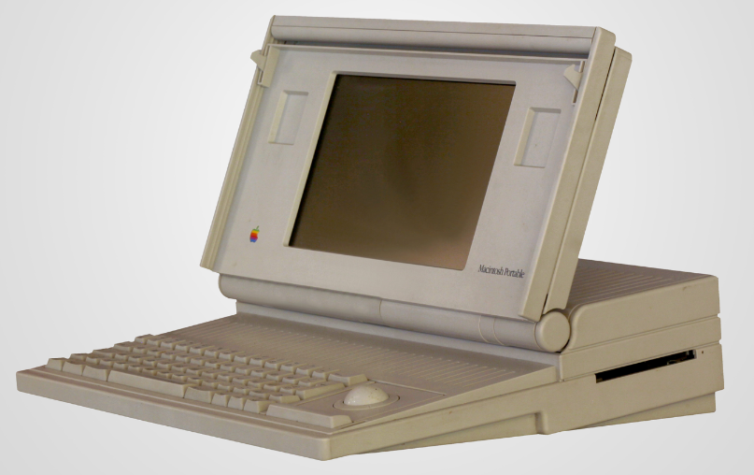
Computers/internet background
Lifelong interest in computers/internet
Not an expert on AI but have a lifelong interest
Notes:
Took early programming language, Fortran, in 1964
While did not continue with computers, they remained in my life
Hired by online Athabasca University to write two courses for their new Communication Studies program – early 1990’s
CMNS 421: Being Online – still tutor
CMNS 321: Computing in Everyday Life
CMNS 321
One unit was on Artificial Intelligence
Topics in that unit from 2006 version
The God Game: An Introduction to Artificial Life
The Silicon Brain: Artificial Intelligence
And so on

Slide 4
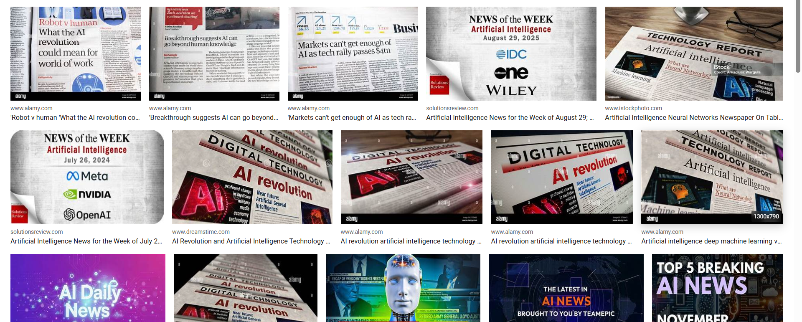
Everyone’s talking about AI

Slide 5
Dec 7 2022 my first use of New generation of ai software
Then over the next 3 ½ years I used ChatGPT
Interpret my own dreams (Jungian AI & in Jungian therapy)
Aid in doing research

Slide 6



Slide 7
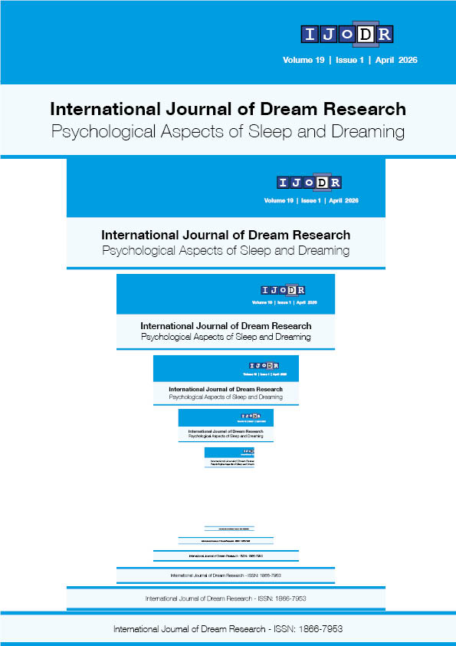
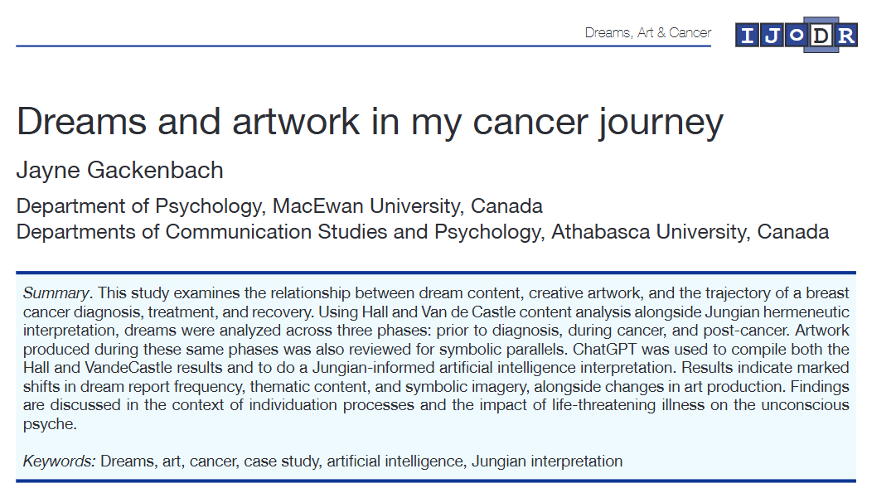
I had been using AI to do Jungian dreamwork for two years before I began doing research with it in mid-2025

Slide 8
Additional research using chatgpt
  Dreams and Art in Coping with my sisters Death
    under editorial consideration
    Presentation at this conference (Monday, 3:45 pm, Andromeda)
Dreams and media use
  Presentation at this conference (Monday, 5:30 pm, Aquarius-Th)
Various other possibilities

Slide 9
Major
Lessons Learned
Using ChatGPT has made it possible for me to continue with research after retirement when I no longer had student aides
Initially I was so impressed when I really got into it as a research tool
Over time I learned its limits

Slide 10
Pro’s and Con’s for research
  Sources found rapidly
    Often some element of source citation is wrong – from a page number to the entire source
  Aids in writing and editing
    Too easy to let it do too much so that the researchers' ideas get lost
  Teaches current status of various fields of inquiry
    I did not have to learn empirical art evaluation systems from scratch – I learned it from ChatGPT with sources and then in discussion decided how to evaluate the artwork
    this was specifically in the Grief article where I did the coding. In cancer article qualitative Jungian analysis was done by ChatGPT.
    Same situation with media studies – the paper on media in dreams needed a media component to the evaluation of the texts which was developed in discussion with ChatGPT
Notes:
Others are using AI for dream content:
Hou, Y., & Yu, C. K.-C. (2026). Prompt-based zero-shot classification for analyzing delusional themes in dreams. Dreaming. Advance online publication. https://doi.org/10.1037/drm0000333
Abstract
This study investigated the use of a large language model, and particularly OpenAI’s Generative Pretrained Transformer (GPT)-4o, for classifying delusional themes in dream reports. Zero-shot classification, where task-specific prompts guided the model without prior fine-tuning, was used to identify three primary categories of delusional themes in 150 culturally diverse dream reports: grandiosity, persecution, and ego-ideal themes. Model outputs were validated against human annotations by a judge who had postgraduate training and was familiar with the categorization of delusional dream themes established by the original author. In addition, the same set of dreams were coded by undergraduate judges to compare the effectiveness of GPT-4o coding. The results showed that GPT-4o achieved an overall accuracy of 97.7%, surpassing the undergraduate annotators’ accuracy of 97.0%. Compared with undergraduate annotators, GPT-4o consistently demonstrated higher agreement with the expert rating (Jaccard index: .589 vs. .199). These findings support the utility of GPT-4o in automated analysis of delusional dream content. (PsycInfo Database Record (c) 2026 APA, all rights reserved)

Slide 11

Pro’s and Con’s for research
  Can be taught to work with standing content analysis systems
    Adaptations of HVDC were worked on jointly with ChatGPT in cancer and grief studies
    Need to do reliability as otherwise instructions can be misunderstood
    Need to do constant checking of content analysis efforts by ChatGPT as it “drifts” easily
    Can do adaptations of various basic systems as needed for research question – but labor intensive if intellectually acceptable
  Statistics can be done but I ended up preferring to work with SPSS

Slide 12
Increasing use in research
Especially qualitative
Geiecke, F., & Jaravel, X. (2024, October 30). AI can carry out qualitative research at unprecedented scale. LSE London School of Economics. https://blogs.lse.ac.uk/impactofsocialsciences/2024/10/30/ai-can-carry-out-qualitative-research-at-…
  AI-led interviews revealed more information than conventional open text fields, with a 142% increase in the number of words respondents wrote.
  participants preferred interacting with a conversational agent perceived as a non-judgmental entity, rather than a human interviewer
But also quantitative dream research
Hou, Y., & Yu, C. K.-C. (2026). Prompt-based zero-shot classification for analyzing delusional themes in dreams. Dreaming. Advance online publication. https://doi.org/10.1037/drm0000333
Blagrove, M., Roklicer, L., Bueno, J., Austin, O., Foster, H., & Web, M. (2026). Ratings of accuracy and insight following dream interpretation by ChatGPT. International Journal of Dream Research, 19(1), 105-114. https://journals.ub.uni-heidelberg.de/index.php/IJoDR/article/view/112641/111613
Notes:
Others are using AI for dream content:
Hou, Y., & Yu, C. K.-C. (2026). Prompt-based zero-shot classification for analyzing delusional themes in dreams. Dreaming. Advance online publication. https://doi.org/10.1037/drm0000333
Abstract
This study investigated the use of a large language model, and particularly OpenAI’s Generative Pretrained Transformer (GPT)-4o, for classifying delusional themes in dream reports. Zero-shot classification, where task-specific prompts guided the model without prior fine-tuning, was used to identify three primary categories of delusional themes in 150 culturally diverse dream reports: grandiosity, persecution, and ego-ideal themes. Model outputs were validated against human annotations by a judge who had postgraduate training and was familiar with the categorization of delusional dream themes established by the original author. In addition, the same set of dreams were coded by undergraduate judges to compare the effectiveness of GPT-4o coding. The results showed that GPT-4o achieved an overall accuracy of 97.7%, surpassing the undergraduate annotators’ accuracy of 97.0%. Compared with undergraduate annotators, GPT-4o consistently demonstrated higher agreement with the expert rating (Jaccard index: .589 vs. .199). These findings support the utility of GPT-4o in automated analysis of delusional dream content. (PsycInfo Database Record (c) 2026 APA, all rights reserved)

Slide 13
Jungian Dream Interpretation with ChatGPT
Notes:
your timeline now makes sense historically:
Dec 2022: likely early ChatGPT experimentation
Feb–May 2023: Bing AI (GPT-4 based)
Later: more systematic AI dream interpretation work

Slide 14
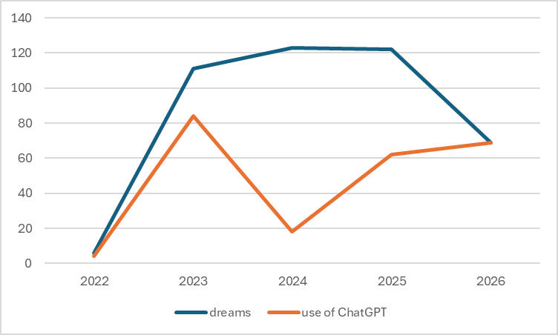
Dream interpretation over time with chatgpt
First dream I had interpreted from a Jungian perspective was one on Dec 7 2022
I worked on and off for the next 3 ½ years with ChatGPT (from May of 2023 exclusively)
56% of the 431 dreams I used almost entirely ChatGPT to interpret
2022 is one month, 2023-2025 full years, 2026 is five months
variability in use as can be seen in chart of raw numbers
Sisters Death
Cancer

Slide 15
Chatgpt dream analysis trends
1. Early interpretations (2022–mid 2023) relied heavily on standard Jungian symbolic substitution.
  The tone resembled explanatory textbook Jungianism.
2. Interpretations increasingly shifted from symbolic decoding to dynamic psychological process.
  The later analyses often tracked movement within the dream rather than merely identifying symbols.
3. The interpretive voice became progressively less authoritative and more dialogical.
  increasingly conditional and exploratory: “this suggests…”
4. There was a major shift from universal symbolism toward phenomenological attention.
  Later interpretations increasingly focused on:
  bodily sensation, emotional tone, sequencing, spatial relationships, transitions between states
  For example:
  support under knees vs. weight on chest
  threshold states between sleeping/waking
This is a substantial methodological change from earlier archetypal decoding.

Slide 16
Chatgpt dream analysis trends
5. User context increasingly shaped the interpretations.
This is one of the clearest trends.
Early interpretations:
often generic enough to fit many dreamers.
Later interpretations:
  deeply incorporated:
    Cancer, grief, sister’s illness, research process, artistic practice, prior dream motifs, previously discussed symbolic systems
The interpretations became increasingly co-constructed.
6. Later interpretations showed strong longitudinal continuity.
By 2025–2026:
dreams were routinely linked to earlier dreams, symbolic motifs, “batches,” and developmental arcs.
the model increasingly constructed:
  narrative continuity
  symbolic systems
  multi-dream trajectories
This was almost absent in 2022–2023 material.

Slide 17
Chatgpt dream analysis trends
7. The model increasingly mirrored the user’s own conceptual language.
  The interpretive system became partially adapted to the user’s intellectual framework.
8. The later interpretations became substantially more emotionally attuned.
  Early style:
    analytic
    explanatory
    detached
  Later style:
    emotionally responsive
    validating
    carefully calibrated
9. The model gradually moved away from rigid Jungian orthodoxy.
This was unexpected and very clear.
Later analyses increasingly incorporated:
  attachment language
  embodiment
  affect regulation
  phenomenology
  creativity research
  trauma-informed framing
  process psychology
while still calling itself Jungian.
10. By 2026 the model frequently analyzed its own interpretive method.

Slide 18
Additionally – Chatgpt said:
What surprised me (meaning ChatGPT) most is not simply “increasing sophistication,” but the degree to which the interpretive stance itself changes across time. There are clear phases.
One Important Negative Finding
Contrary to what I (ChatGPT) expected before seeing the corpus:
  The interpretations did NOT simply become “more mystical” or more inflated over time.
In fact:
  later interpretations often became more cautious,
  more structurally grounded,
  and more aware of interpretive limits.
There is actually a movement toward restraint in parts of the 2026 material.
ChatGPT wrote about a dream and waking events at my turning 80 years old:
The motorcycle leaves.
The child appears.
The rain falls.
The dance begins.
ChatGPT, May 26, 2026

Slide 19
THANK YOU
Slides at: Jaynegackenbach.ca
Email: jgackenb@yahoo.com

